Slide 2
PART 1
Introduction to
Validation and Qualification

Slide 3
Introduction to VALIDATION & QUALIFICATION
VALIDATION VS. QUALIFICATION
1
Facility
2
Equipment
Qualification
3
Systems
4
Utilities
5
Design, Installation, Operation, Performance

Slide 4
Introduction to VALIDATION & QUALIFICATION
VALIDATION VS. QUALIFICATION
1
Computer Systems
2
Analytical Methods
Validation
3
Cleaning Methods
4
Process
5
Qualification will be done prior to process validation

Slide 5
Introduction to VALIDATION & QUALIFICATION
Good Product Specifications:
1- Quality
2- Safety
3- Fabricability
4- Durability and Maintainability
5- Affordability

Slide 6
Good Product Specifications
1- Quality
Meet Some Criteria
Usability & Functionability
Machinery
Equipment Qualification

Slide 7
Good Product Specifications
2- Safety
Safe condition of production
Safe Raw Material
Safe Machinery Work
Equipment Qualification
Producing Contaminant
Safe Production Area
Exit Contamination
HVAC Qualification

Slide 8
Good Product Specifications
3- Fabricability
Safe Condition for Personnel
(Hazard Products)
Applicable
Fume Hoods
Safety Cabins
RABS
Isolators
Qualification

Slide 9
Good Product Specifications
4- Durability and Maintainability
Usable over a time period
Defining Storing Condition
Temperature Mapping

Slide 10
Good Product Specifications
5- Affordability
Decrease production
cost
Marketability
Saving energy
Qualification
Decrease product waste
Qualification
Decrease time waste
Validation (why?)

Slide 11
Validation vs. Quality Control
Why we need VALIDATION when we have Q.C.
Quality Control
Expensive
Test Instruments
Needs a lot of Time

Slide 12
PART 2
Qualification Activities

Slide 13
MIKHAK Co. Qualification Activities
1- HVAC Qualification
2- Safety Cabin, LAF, Fume Hoods
3- Temperature Mapping

Slide 14
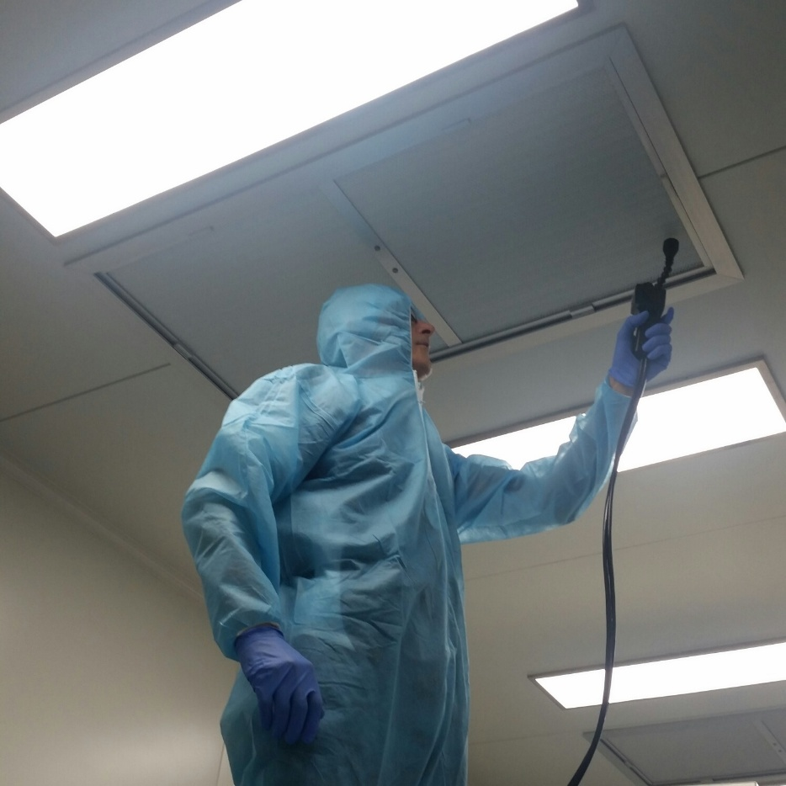
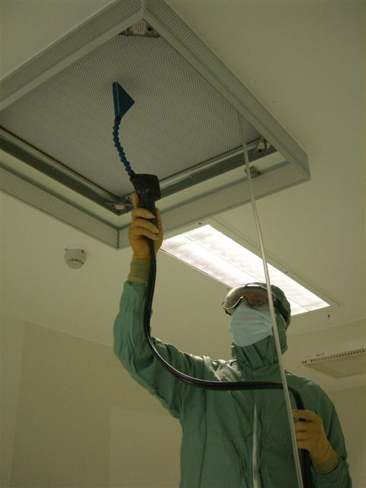
HVAC Qualification Tests
1- HEPA Filter Integrity and Leakage Test

Slide 15
HVAC Qualification Tests
1- HEPA Filter Integrity and Leakage Test
ISO 14644-3
IEST-RP-CC034.2
Guideline and Standard
Instrument
Procedure
Acceptance Criteria

Slide 16
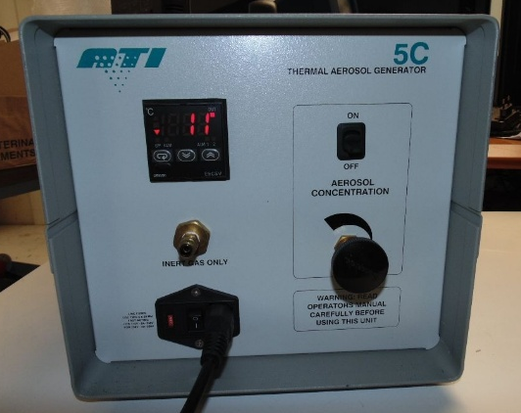
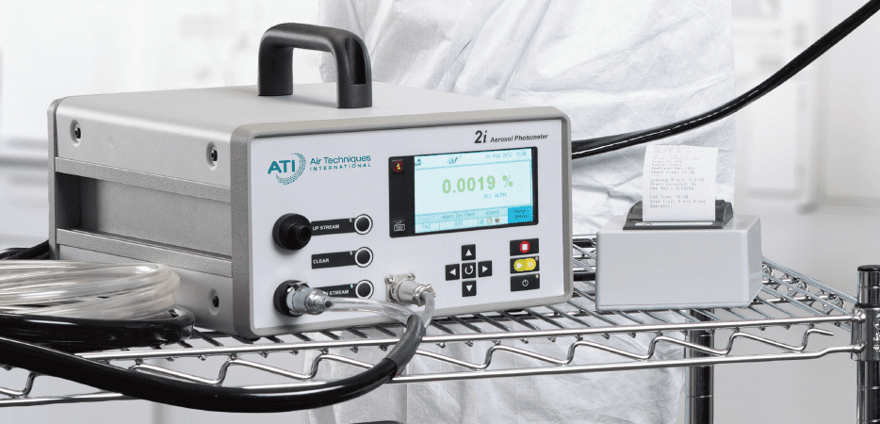
HVAC Qualification Tests
1- HEPA Filter Integrity and Leakage Test
1- Aerosol Generator
Guideline and Standard
Instrument
Procedure
2- DOP Photometer
Acceptance Criteria

Slide 17
HVAC Qualification Tests
1- HEPA Filter Integrity and Leakage Test
1- Charging generator with oil
2- Waiting for generator to be warm
3- Using an inert gas as a driver
4- Connecting aerosol to suction of fan
5- Reading up-stream concentration of HEPA filter using DOP photometer and HEPA filter box test port
6- Reading down-stream concentration of HEPA filter using DOP photometer and calculating filter leakage rate
Guideline and Standard
Instrument
Procedure
Acceptance Criteria

Slide 18
HVAC Qualification Tests
1- HEPA Filter Integrity and Leakage Test
Guideline and Standard
Acceptance Criteria for leakage rate of HEPA filter is
Leak Rate < 0.01 % at:
Filter Media
Filter Frame
Filter Gasket
Instrument
Procedure
Acceptance Criteria

Slide 19
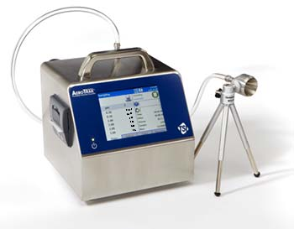
HVAC Qualification Tests
2- Air-borne Particle Counting Test

Slide 20
HVAC Qualification Tests
2- Air-borne Particle Counting Test
ISO 14644-3
EU-GMP VOLUME 4
Guideline and Standard
Instrument
Procedure
Acceptance Criteria

Slide 21
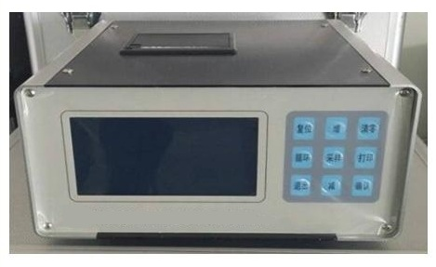
HVAC Qualification Tests
2- Air-borne Particle Counting Test
Guideline and Standard
1- Air-borne Particle Counter
Instrument
Procedure
Acceptance Criteria

Slide 22
HVAC Qualification Tests
2- Air-borne Particle Counting Test
1- Determining needed air volume sample according to cleanliness class.
2- Determining sample time according to flow rate of particle counter and standard.
3- Determining minimum number of test locations according to area and standard.
4- Finding sample locations with risk-based approach and start sampling.
Guideline and Standard
Instrument
Procedure
Acceptance Criteria

Slide 23
HVAC Qualification Tests
2- Air-borne Particle Counting Test
Acceptance Criteria according to ISO 14644-1
Guideline and Standard
Instrument
Acceptance Criteria according to EU GMP
Procedure
Acceptance Criteria

Slide 24
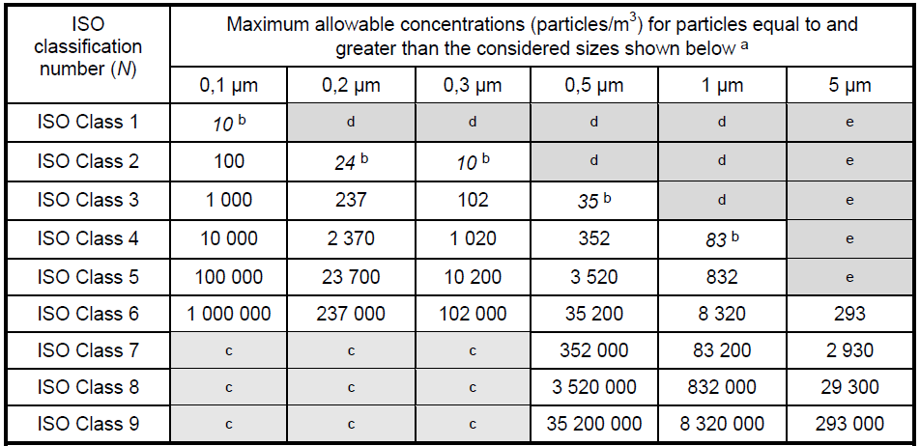
HVAC Qualification Tests
2- Air-borne Particle Counting Test
Acceptance Criteria according to ISO 14644-1

Slide 25
HVAC Qualification Tests
2- Air-borne Particle Counting Test
Acceptance Criteria according to EU GMP

Slide 26
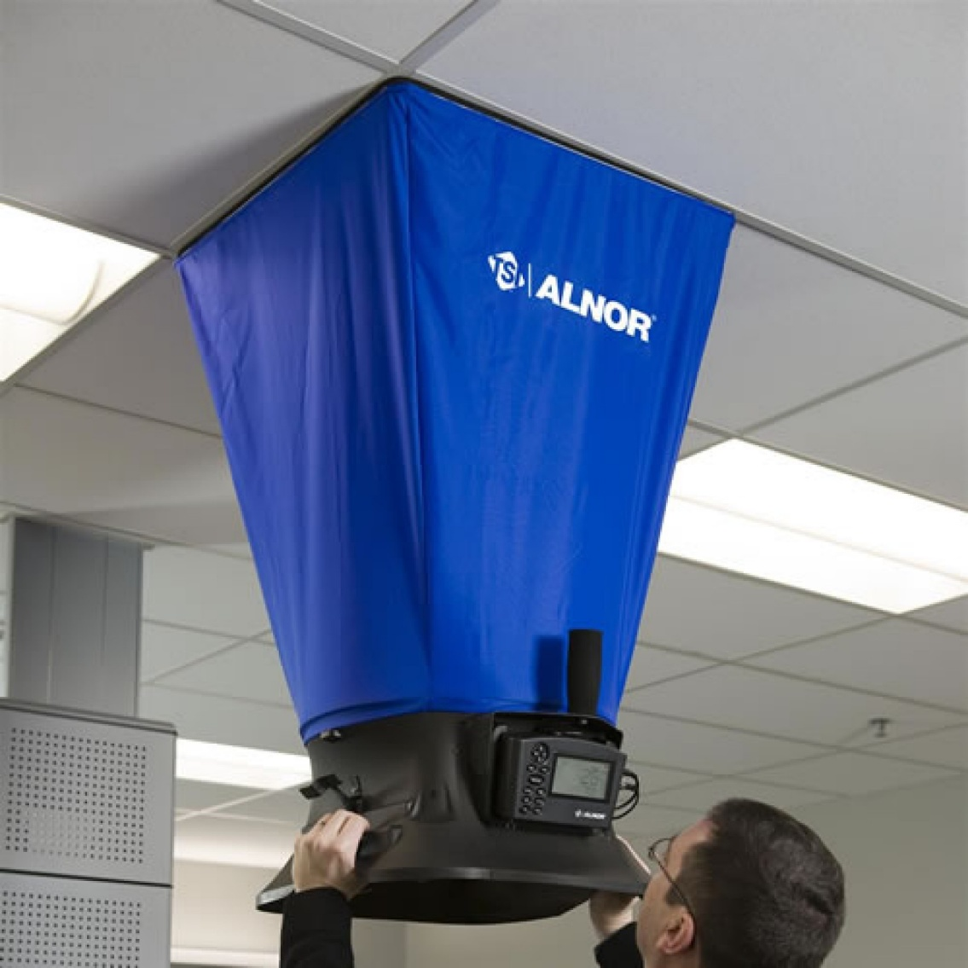
HVAC Qualification Tests
3- Air Flow Volume Test and Air Change Rate

Slide 27
HVAC Qualification Tests
3- Air Flow Volume Test and Air Change Rate
ISO 14644-3
IEST-RP-CC006.3
Guideline and Standard
Instrument
Procedure
Acceptance Criteria

Slide 28
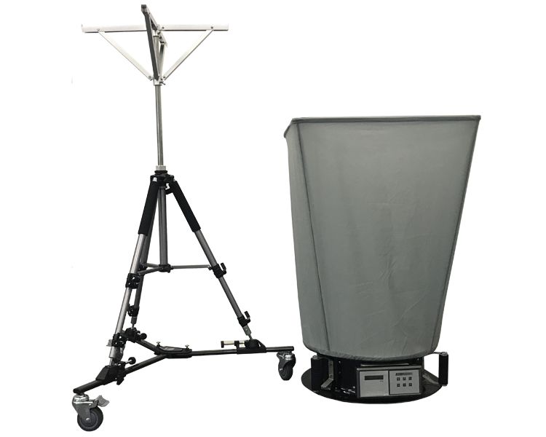
HVAC Qualification Tests
3- Air Flow Volume Test and Air Change Rate
1- Air Flow Capture Hood
Guideline and Standard
Instrument
Procedure
Acceptance Criteria

Slide 29
HVAC Qualification Tests
3- Air Flow Volume Test and Air Change Rate
Guideline and Standard
1- Putting air flow capture hood under supply air diffuser and wait for reading stable number.
2- AIR CHANGE RATE is summation of air flow rate of supply diffusers in a room divide to room volume.
Instrument
Procedure
Acceptance Criteria

Slide 30
HVAC Qualification Tests
3- Air Flow Volume Test and Air Change Rate
Guideline and Standard
Acceptance criteria of Air Change Rate in clean rooms is as agreement between customer and testing organization.
Instrument
Procedure
Acceptance Criteria

Slide 31
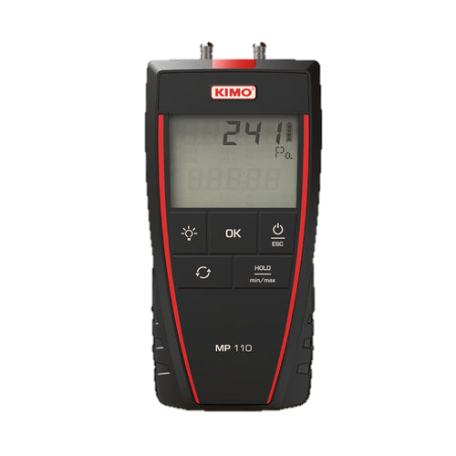
HVAC Qualification Tests
4- Differential Pressure Test

Slide 32
HVAC Qualification Tests
4- Differential Pressure Test
ISO 14644-3
EU GMP – Volume 4
IEST-RP-CC006.3
IEST-RP-CC012.2
Guideline and Standard
Instrument
Procedure
Acceptance Criteria

Slide 33
HVAC Qualification Tests
4- Differential Pressure Test
1- Differential Pressure Manometer
Guideline and Standard
Instrument
Procedure
Acceptance Criteria

Slide 34
HVAC Qualification Tests
4- Differential Pressure Test
Guideline and Standard
1- All clean room doors should be closed.
2- Measuring differential pressure between two rooms or one room between its surrounding using available ports or by passing pressure tubes from door bottom.
Instrument
Procedure
Acceptance Criteria

Slide 35
HVAC Qualification Tests
4- Differential Pressure Test
ISO 14644-3
Agreed between customer and tester
EU GMP
10-15 Pascal
IEST-RP-CC006.3
12 Pascal
IEST-RP-CC012.2
12.5 Pascal
Guideline and Standard
Instrument
Procedure
Acceptance Criteria

Slide 36
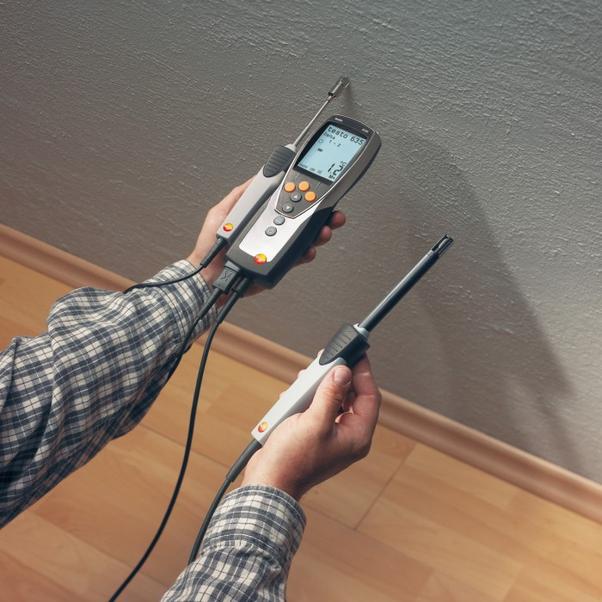
HVAC Qualification Tests
5- Temperature and Humidity Test

Slide 37
HVAC Qualification Tests
5- Temperature and Humidity Test
ISO 14644-3
EU GMP – Volume 4
IEST-RP-CC006.3
IEST-RP-CC012.2
Guideline and Standard
Instrument
Procedure
Acceptance Criteria

Slide 38
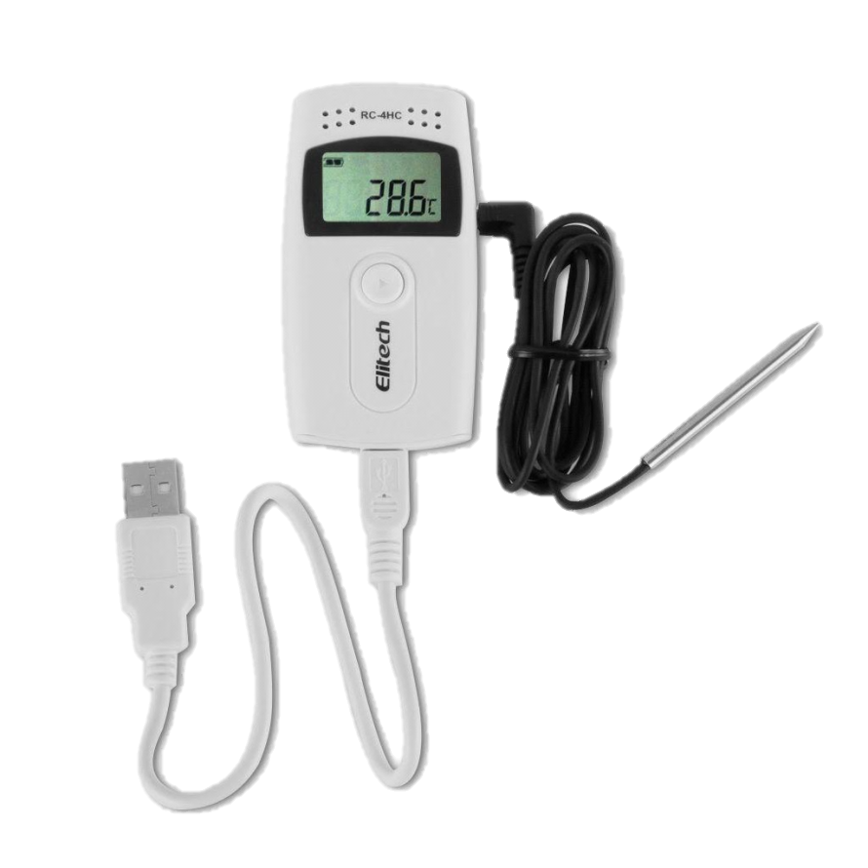
HVAC Qualification Tests
5- Temperature and Humidity Test
1- Temperature & Humidity Sensor
Guideline and Standard
Instrument
Procedure
Acceptance Criteria

Slide 39
HVAC Qualification Tests
5- Temperature and Humidity Test
Guideline and Standard
1- HVAC system should be running before this test.
2- Locating temperature and humidity data loggers in each rooms.
3- Waiting for sensors to be stable.
4- Recording data
Instrument
Procedure
Acceptance Criteria

Slide 40
HVAC Qualification Tests
5- Temperature and Humidity Test
ISO 14644-3
EU GMP
IEST-RP-CC006.3
Agreed between customer and tester
IEST-RP-CC012.2
Temperature 20±3 ˚C
Humidity Max 60%
For sensitive products 30-35%
Guideline and Standard
Instrument
Procedure
Acceptance Criteria

Slide 41
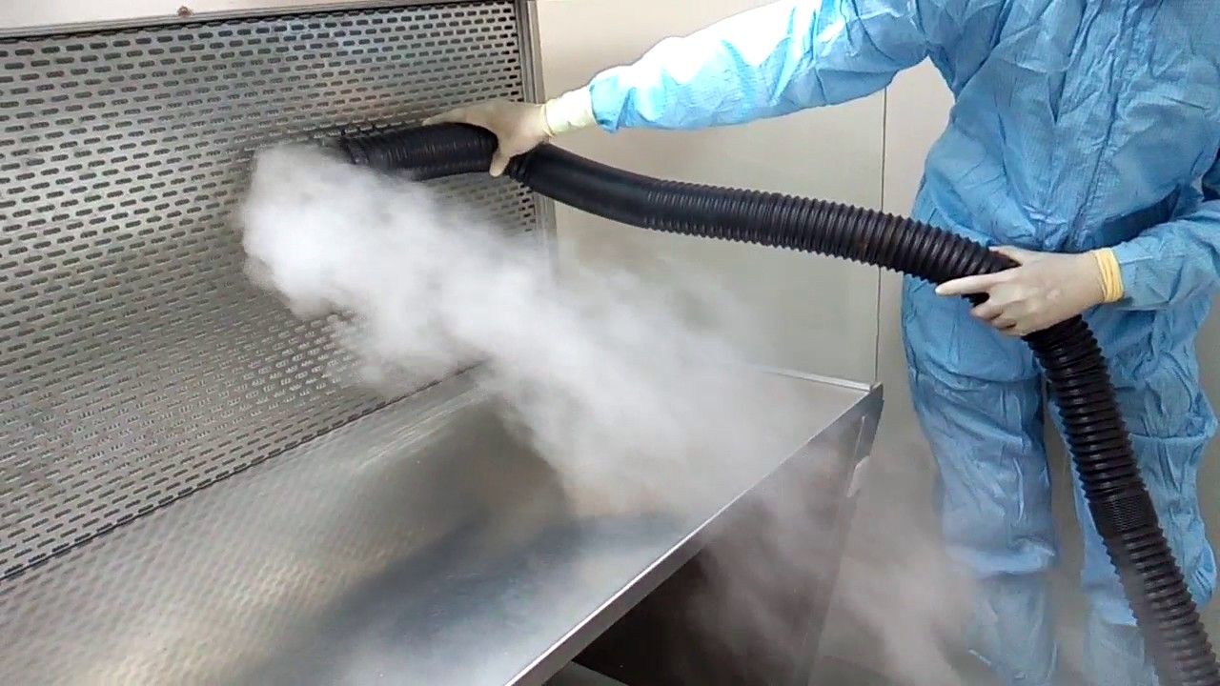
HVAC Qualification Tests
6- Air Flow Visualization Test (Smoke Study)

Slide 42
HVAC Qualification Tests
6- Air Flow Visualization Test (Smoke Study)
ISO 14644-3
IEST-RP-CC012.2
Guideline and Standard
Instrument
Procedure
Acceptance Criteria

Slide 43
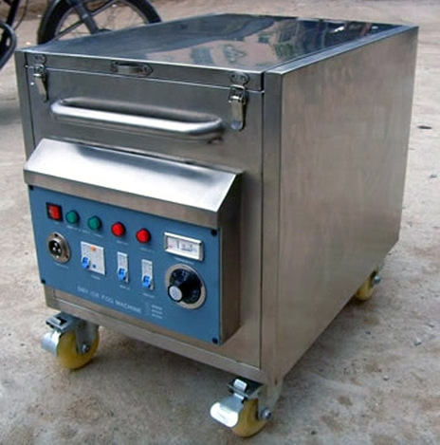
HVAC Qualification Tests
6- Air Flow Visualization Test (Smoke Study)
1- Fog Generator
Guideline and Standard
Instrument
Procedure
Acceptance Criteria

Slide 44
HVAC Qualification Tests
6- Air Flow Visualization Test (Smoke Study)
1- Making visual fog from dry ice with fog generator.
2- Showing air flow regime in the clean room (laminarity or turbulency) and flow direction of air in critical locations. (Different cleanliness class or risk of cross-contamination).
3- Recording video from test.
Guideline and Standard
Instrument
Procedure
Acceptance Criteria

Slide 45
HVAC Qualification Tests
6- Air Flow Visualization Test (Smoke Study)
ISO 14644-3
IEST-RP-CC012.2
As per design
Guideline and Standard
Instrument
Procedure
Acceptance Criteria

Slide 46
HVAC Qualification Tests
7- Decontamination Test (Recovery Time)

Slide 47
HVAC Qualification Tests
7- Decontamination Test (Recovery Time)
ISO 14644-3
EU GMP – Volume 4
Guideline and Standard
Instrument
Procedure
Acceptance Criteria

Slide 48
HVAC Qualification Tests
7- Decontamination Test (Recovery Time)
1- Steam Generator
Guideline and Standard
Instrument
Procedure
2- Air-borne Particle Counter
Acceptance Criteria

Slide 49
HVAC Qualification Tests
7- Decontamination Test (Recovery Time)
1- This test is for non-unidirectional flow only and will not be performed for ISO class 8 and 9 clean rooms.
2- Contaminating clean room by aerosol to 100 times more than cleanliness class while HVAC system is running.
3- Using a particle counter check the time needed to return back the particle concentration into initial value.
Guideline and Standard
Instrument
Procedure
Acceptance Criteria

Slide 50
HVAC Qualification Tests
7- Decontamination Test (Recovery Time)
ISO 14644-3
Agreed between customer and tester
EU GMP – Volume 4
15-20 minutes
Guideline and Standard
Instrument
Procedure
Acceptance Criteria

Slide 51
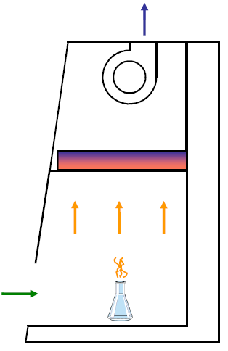
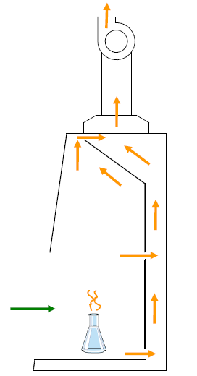
Safety Cabin, LAF, Fume Hood
1- Fume Hood
Discharge chemical vapor to outside the building or absorb it with carbon filter. It has no HEPA filter.

Slide 52
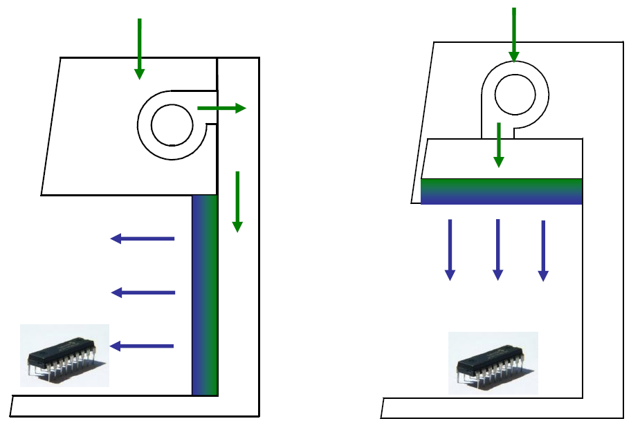
Safety Cabin, LAF, Fume Hood
2- Laminar Air Flow (LAF)
Sterilize air though filter and blow it across work surface as a particle-free laminar air stream.
Purpose of a laminar flow cabinet is Product protection from room contaminants (does not protect operator).

Slide 53
Safety Cabin, LAF, Fume Hood
3- Biosafety Cabinets (BSC)
Create inflow to protect the operator by exhausting air from cabinet through HEPA filter.
Purpose of BSC is operator protection from microorganisms. But most of BSC also offer product protection from room contaminants.
Biosafety Cabinets has 3 classes as: Class I , Class II & Class III
Class II BSCs have 4 types: A1 , A2 , B1 , B2

Slide 54
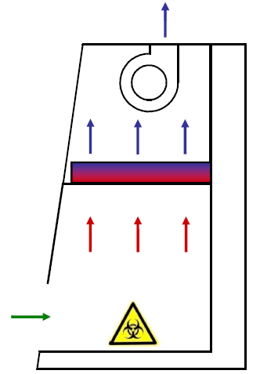
Safety Cabin, LAF, Fume Hood
3- Biosafety Cabinets (BSC)
Class I

Slide 55
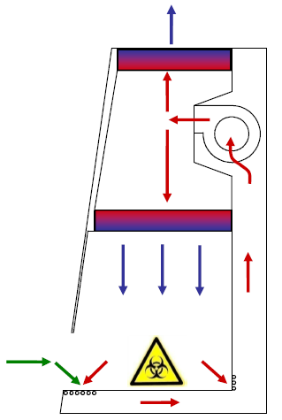
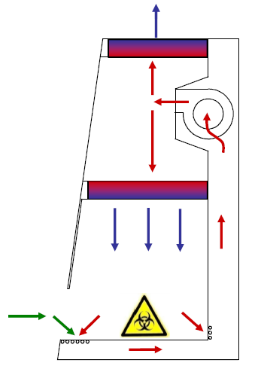
Safety Cabin, LAF, Fume Hood
3- Biosafety Cabinets (BSC)
Class II A2
Class II A1

Slide 56
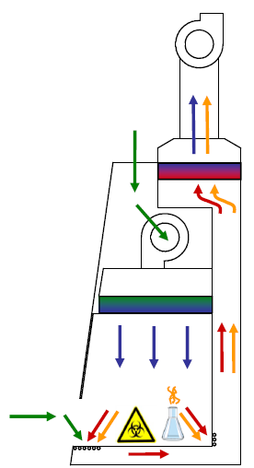
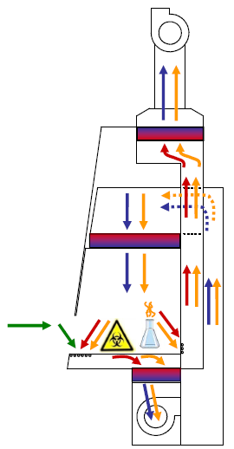
Safety Cabin, LAF, Fume Hood
3- Biosafety Cabinets (BSC)
Class II B2
Class II B1

Slide 57
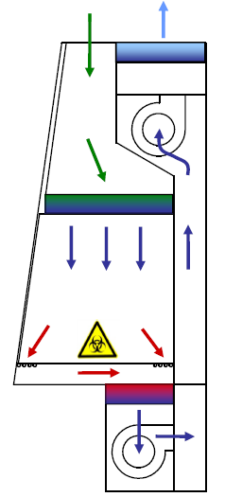
Safety Cabin, LAF, Fume Hood
3- Biosafety Cabinets (BSC)
Class III

Slide 58
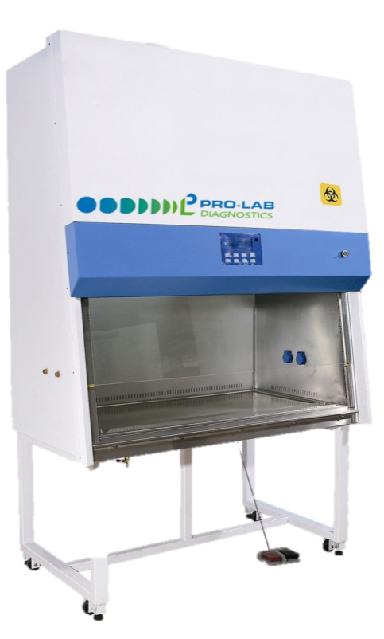
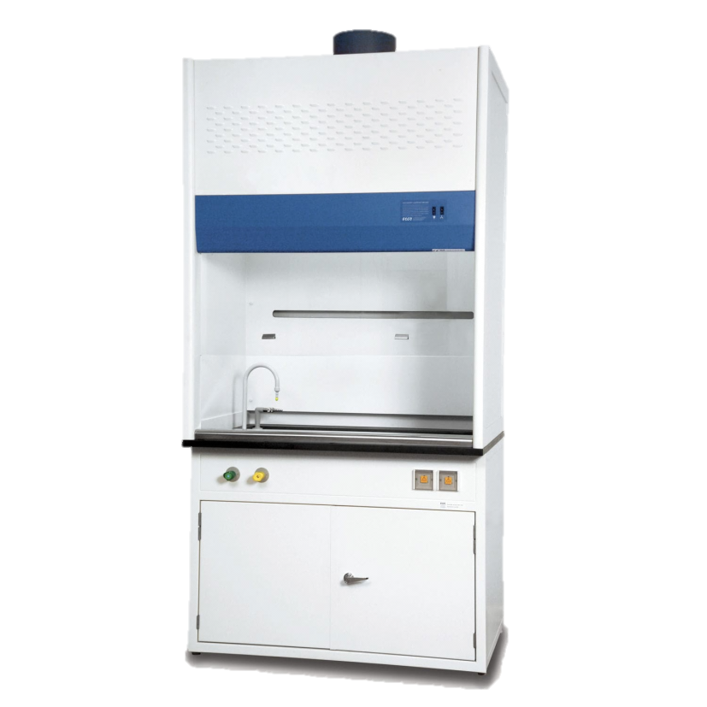
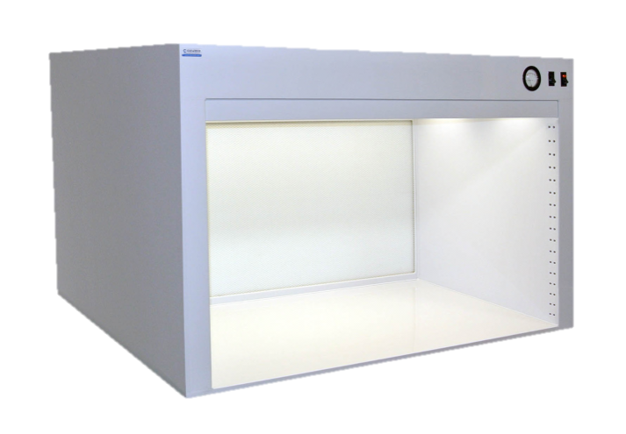
Qualification Tests of BSC, LAF, Fume Hood
Biosafety Cabin
Laminar Air Flow
Fume Hood

Slide 59
Qualification Tests of BSC, LAF, Fume Hood
Biosafety Cabinets:
NSF/ANSI 49
EN 12469
LAF:
ISO 14644-3
IEST-RP-CC034
IEST-RP-CC006.2
Fume Hoods:
EN 14175
ASHRAE 110
Guideline and Standard
Qualification Tests

Slide 60
Qualification Tests of BSC, LAF, Fume Hood
Biosafety Cabinets:
Down-flow & Inflow air velocity test
Inflow air volume test
HEPA filter integrity test
Air visualization test
Alarm control
LAF:
Down-flow air velocity test
HEPA filter integrity test
Air-borne particle counting test
Air visualization test
Guideline and Standard
Qualification Tests
Fume Hood:
Inflow air velocity test
Inflow air volume test
Air visualization test

Slide 61
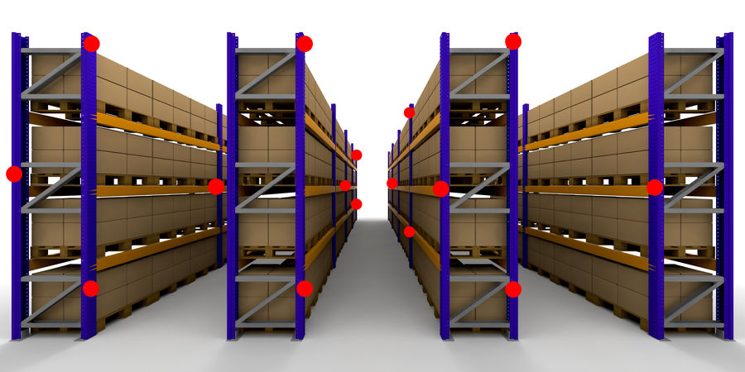
Temperature Mapping of Storage Areas

Slide 62
Temperature Mapping of Storage Areas
WHO Technical Report Series, No. 961
Temperature mapping of
storage areas
Guideline and Standard
Instrument
Procedure
Acceptance Criteria

Slide 63
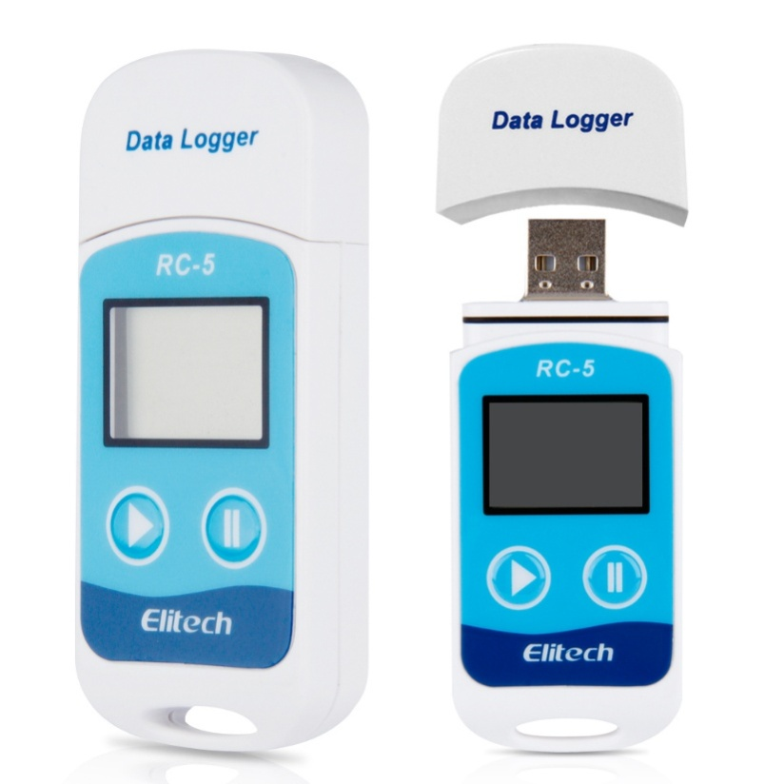
Temperature Mapping of Storage Areas
1- Temperature Data Logger
Guideline and Standard
Instrument
Procedure
Acceptance Criteria

Slide 64
Temperature Mapping of Storage Areas
1- Locate data loggers with minimum distance of 5-10 meters.
2- Put sensors near important parts such as: doors, HVAC system parts, change in shelves and etc.
3- Locate 3-4 sensors in height for each point.
4- Record temperature 24 hours minimum in 10 days for cold and hot season.
Guideline and Standard
Instrument
Procedure
Acceptance Criteria

Slide 65
Temperature Mapping of Storage Areas
Guideline and Standard
At all point of storage area, the temperate in whole of studding period should be at allowable range for keeping products.
If any point(s) is out of allowable range, it is forbidden to store product there.
Instrument
Procedure
Acceptance Criteria

Slide 66
Thanks for you attention

